Slide 1
IoT Based Real Time Water Quality Monitoring System
Group Member:
Attiq ur Rehman
Muhammad Faizan
Supervisor:
Dr. Safeer Hyder
Assistant Professor

Slide 2
Aims:
Designing a Real Time IoT Based Water Quality Monitoring System
Objectives:
An open-source and indigenous platform development for Environmental Monitoring
Reduce import cost
Improve local capacity building

Slide 3
Methodology:
Water Quality Monitoring Sensors' data acquisition platform
Wireless based data exchange from nodes to IoT cloud
Real-time data visualization using IoT based dashboard
Deployment of design in University of Sukkur IBA water supply system

Slide 4
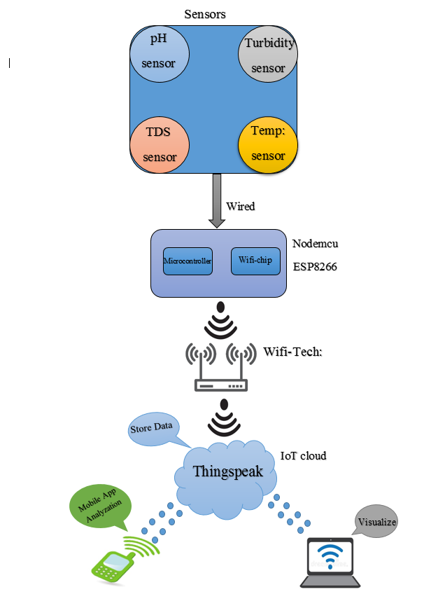
Framework Diagram:

Slide 5
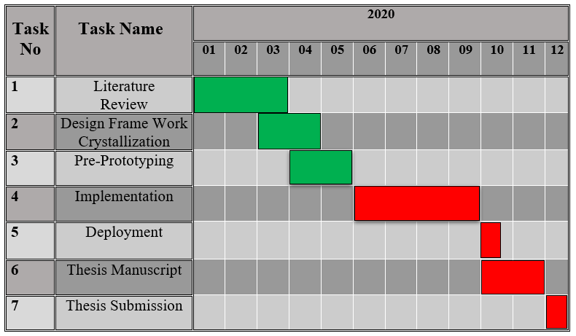
Project Plan/Gantt Chart:
Green: Completed task
Red: Future task

Slide 6
Current Progress:
Literature review
Framework crystallization
Components selection
Place order of components
Learn about IoT cloud (ThingSpeak)
Performed mini projects of IoT
Measure & analyze temperature
Measure & analyze Humidity
Control the state of LED
Manage & organized our projects on GitHub
Develop android app

Slide 7
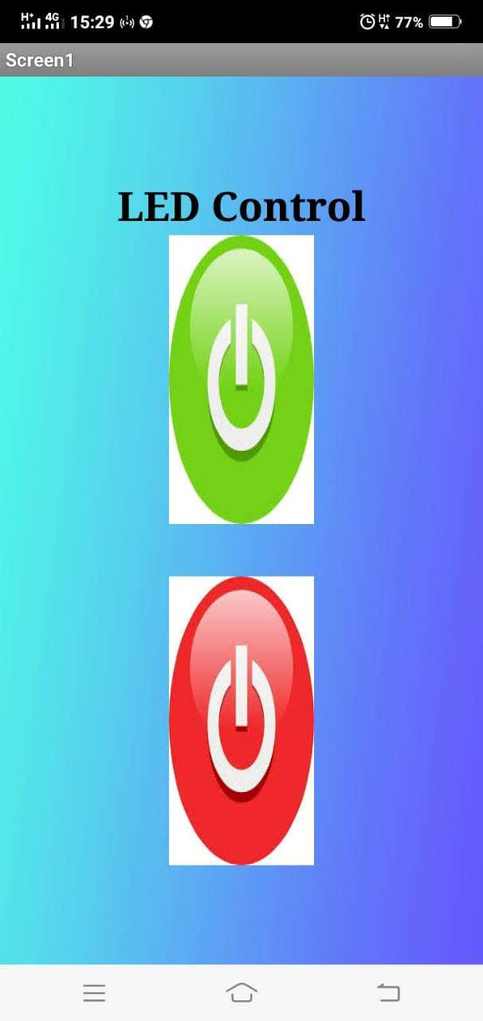
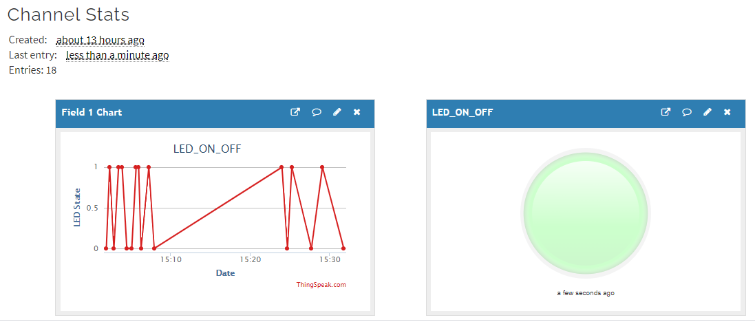
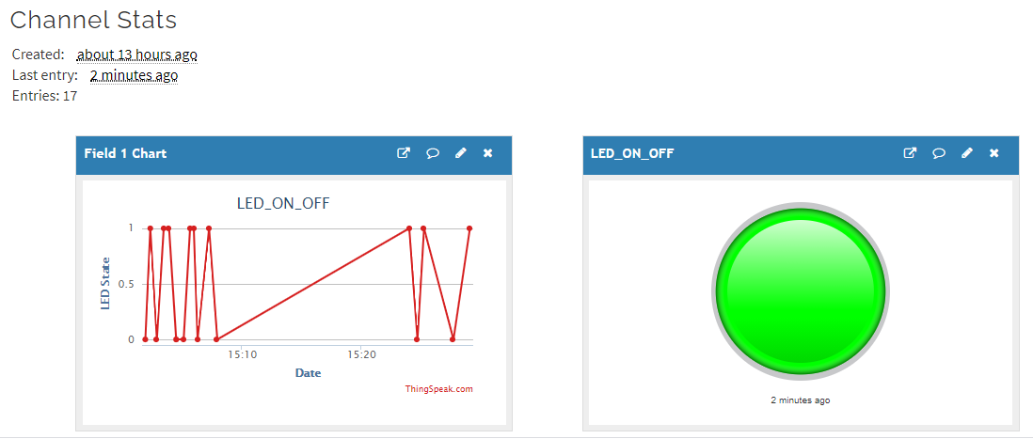
LED Control

Slide 8
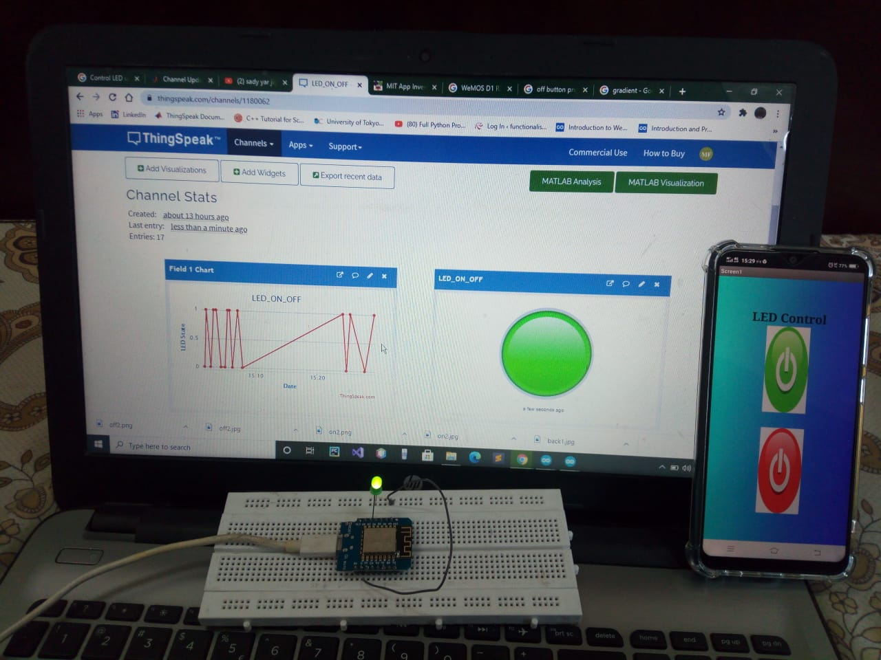
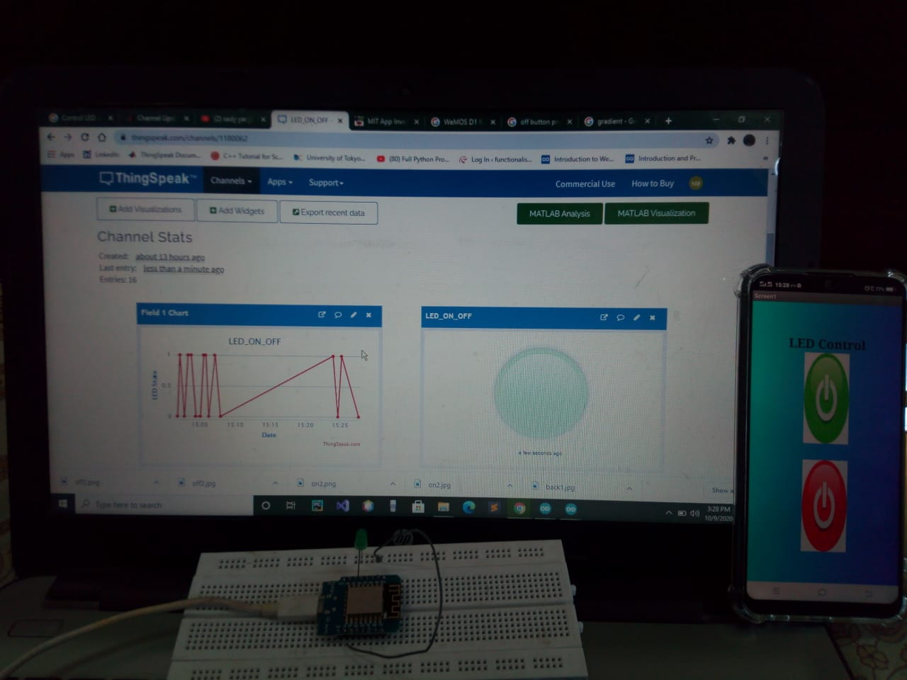
LED Control

Slide 9
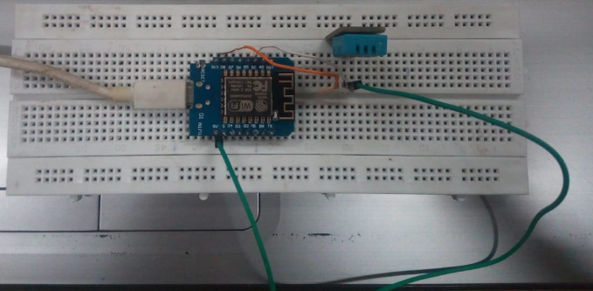
Interface Temperature & Humidity Sensor

Slide 10
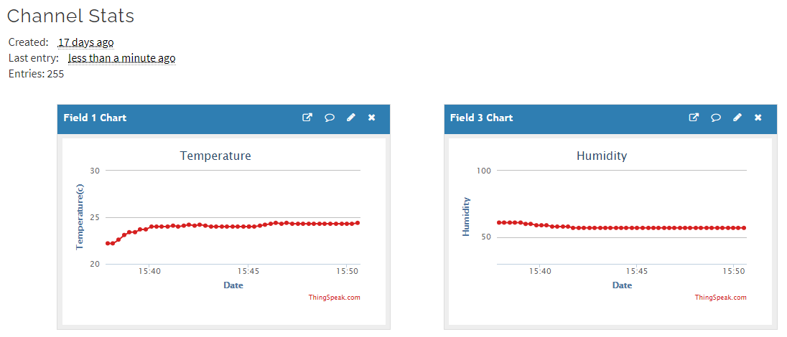
Results

Slide 11
Future tasks:
Interface sensors used in our project
Measure & upload results on cloud
Develop smart & user-friendly android app to visualize results
Testing in different conditions
Design the prototype and chassis

Slide 12
References:
[1] An Exploratory Approach to Monitor the Quality of Supply-Water Through IoT Technology. 2019 International Conference on Automation, Computational and Technology Management (ICACTM) Amity University.
[2] Water Quality Monitoring System Based on IoT. Advances in Wireless and Mobile Communications. ISSN 0973-6972 Volume 10, Number 5 (2017), pp. 1107-1116 © Research India Publications.
[3] Water Quality Analyzer using IoT. International Journal of Innovative Technology and Exploring Engineering (IJITEE) ISSN: 2278-3075, Volume-8, Issue-8S, June 2019.
[4] IoT Based Real-time River Water Quality Monitoring System. The 16th International Conference on Mobile Systems and Pervasive Computing (MobiSPC) sAugust 19-21, 2019, Halifax, Canada.
[5] Vaishnavi V. Daigavane and Dr. M.A Gaikwad “Water Quality Monitoring System Based on IoT”. Advances in Wireless and Mobile Communications. ISSN 0973-6972 Volume 10, Number 5 (2017), pp. 1107-1116 © Research India Publications.
[6] Manoharan.S, Sathiyaraj.G, Thiruvenkadakrishnan.K, Vetriselvan.G.V, Praveenkishor “Water Quality Analyzer using IoT”. International Journal of Innovative Technology and Exploring Engineering (IJITEE) ISSN: 2278-3075, Volume-8, Issue-8S, June 2019.
[7] Salahudin Chowdhary, Talha bin Imran, Abhijit Phatak, “IoT Based Real-time River Water Quality Monitoring System”. The 16th International Conference on Mobile Systems and Pervasive Computing (MobiSPC) August 19-21, 2019, Halifax, Canada.
[8] https://www.worldwatersolar.com/40-of-all-deaths-in-pakistan-are-caused-by-water-contamination/
[9] JAYTI BHATT,JIGNESH PATOLIYA “IOT BASED WATER QUALITY MONITORING SYSTEM ”. International Journal of Industrial Electronics and Electrical Engineering, ISSN: 2347-6982
[10] Vaishnavi V. Daigavane and Dr. M.A Gaikwad “Real time Iot based water monitoring system” advances in Wireless and Mobile Communications. ISSN 0973-6972 Volume 10, Number 5 (2017), pp. 1107-1116 © Research India Publication

Slide 13


